Slide 1

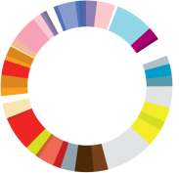

2006
2018
SCALEUP
2017
2016
HUDDLE
2014
2013
G20
2008
GEW IS LAUNCHED
2006
DYNAMIC EC IS LAUNCHED
2002
Start of work of the Center for Entrepreneurship

